Slide 1
Design Problem 1
Approved Solution

Slide 2
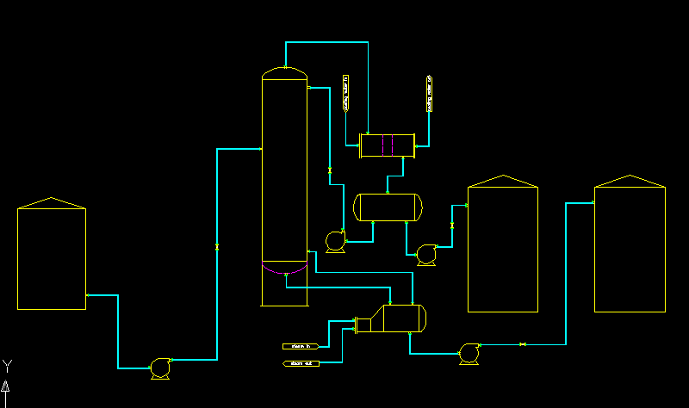
reflux valve
condenser
column
10 trays
280 C
reflux
pump
reflux
tank
feed valve
feed tank
bottoms
product
tank
distillate
pump
distillate
tank
reboiler
bottoms valve
bottoms pump
feed pump

Slide 3
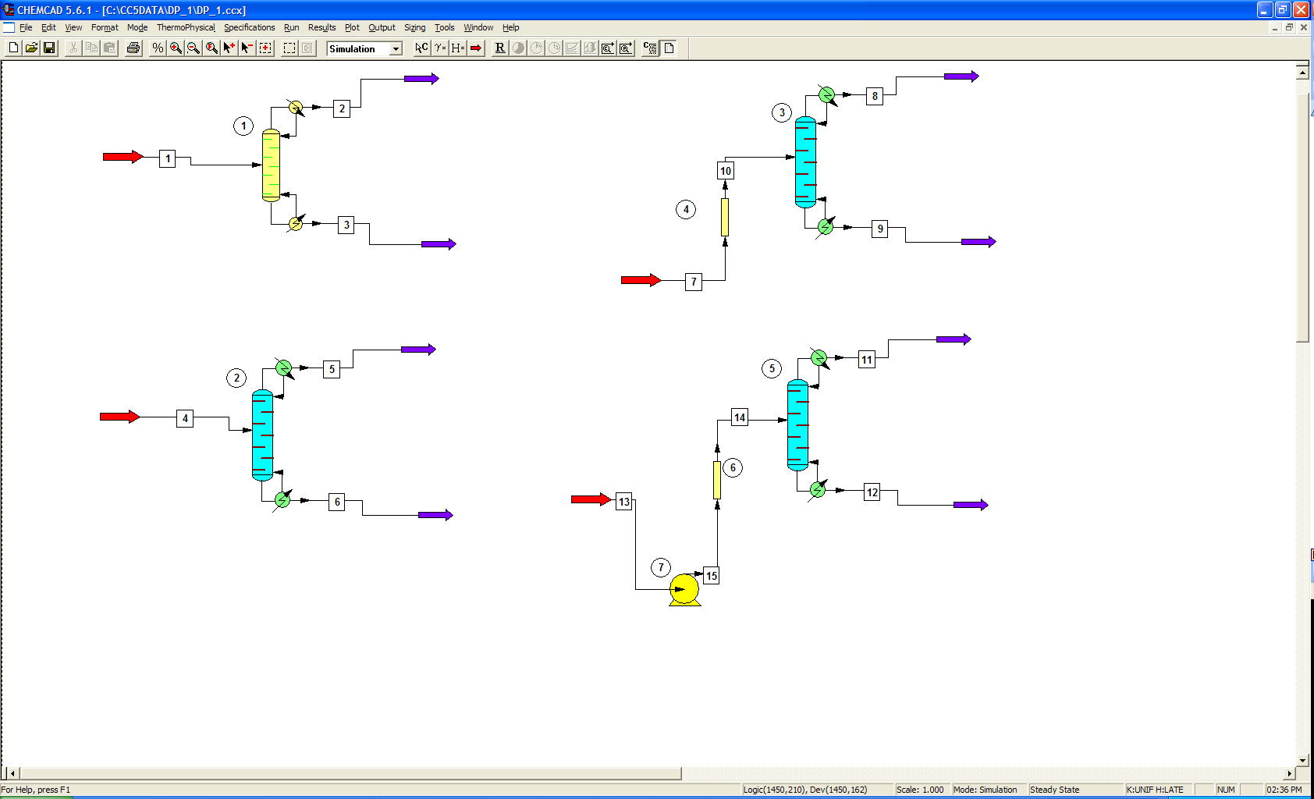
ChemCAD design Procedure
Details are added in steps. The first step is the shortcut column.
Click image to access ChemCAD files

Slide 4
